Slide 1
108 SEATS. ZERO HISTORY. ONE ELECTION NIGHT.
READING THE RESULTS. NO SPIN. JUST DATA
PRESENTED TO ATLIQ MEDIA | 2026

Slide 2
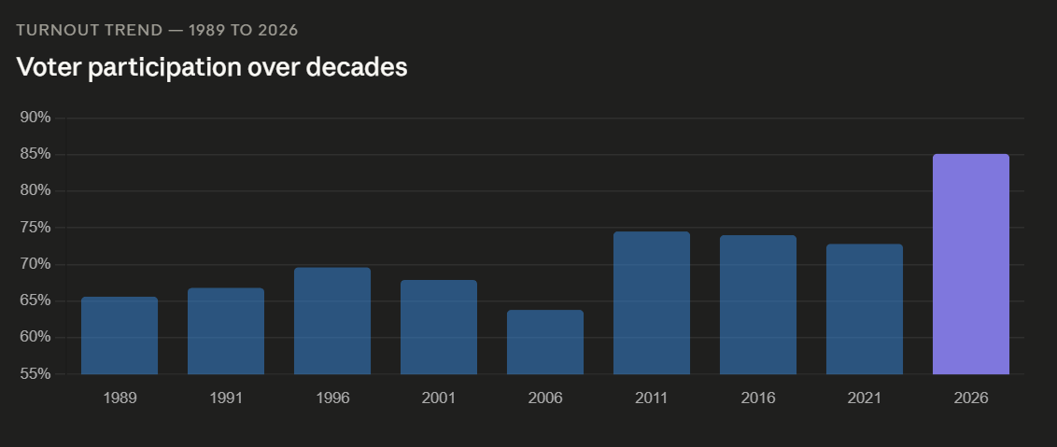
7 IN 10 CONSTITUENCIES CHANGED HANDS
THE MOST SEATS TO FLIP IN A SINGLE TAMIL NADU ELECTION
"70% OF TAMIL NADU VOTED DIFFERENTLY IN 2026 THAN IN 2021"

Slide 3




WHERE DID THE SEATS GO?
DMK
AIADMK
INC
65
26
11
TVK
TVK ENTERED WITH ZERO SEATS. LEFT WITH 108.

Slide 4
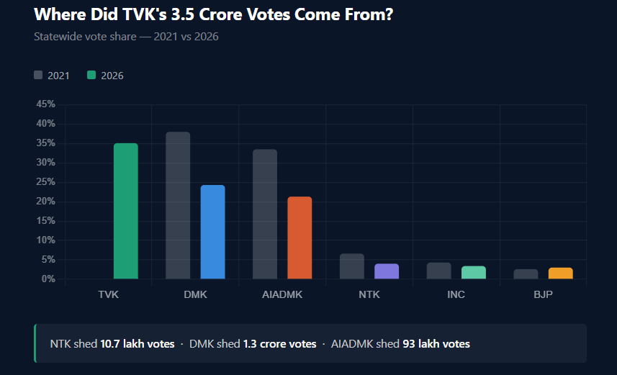
TVK'S 3.5 CRORE VOTES - WHERE DID THEY COME FROM?
NTK SHED 10.7 LAKH VOTES. DMK SHED 1.3 CRORE. AIADMK SHED 93 LAKH.

Slide 5
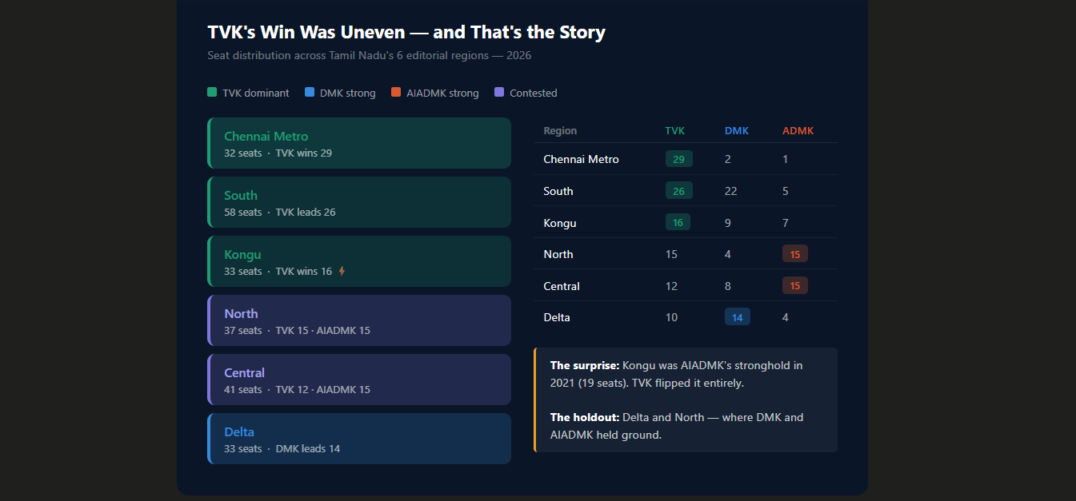
TVK'S WIN WAS UNEVEN — AND THAT'S THE STORY
DELTA AND NORTH — THE REGIONS TVK DIDN'T DOMINATE.

Slide 6
A SQUEEZED ELECTION CLOSER THAN THE SEATS SUGGEST
2021
AVG MARGIN - 22,871 VOTES
2026
AVG MARGIN - 16,784 VOTES
61 SEATS WERE WON WITH LESS THAN 35% OF VALID VOTES - IN A FRAGMENTED FIELD, A SPLIT OPPOSITION HANDED TVK THE MAP

Slide 7
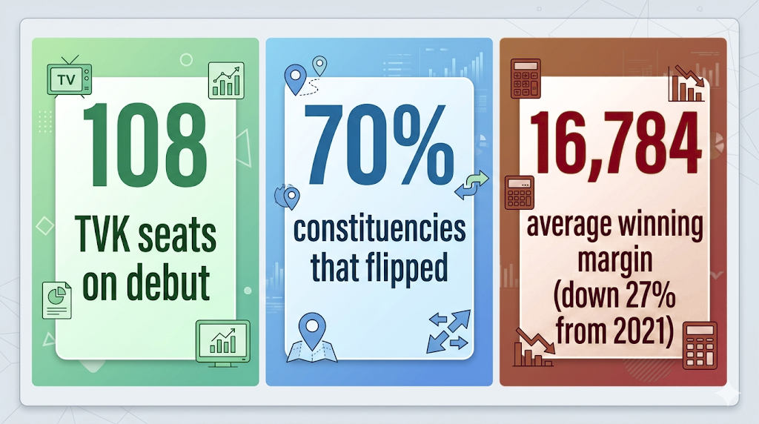
THREE NUMBERS FOR THE SHOW
SOURCE: ECI DATA ONLY · NO SPIN. NO COMMENTARY. JUST NUMBERS.

Slide 8
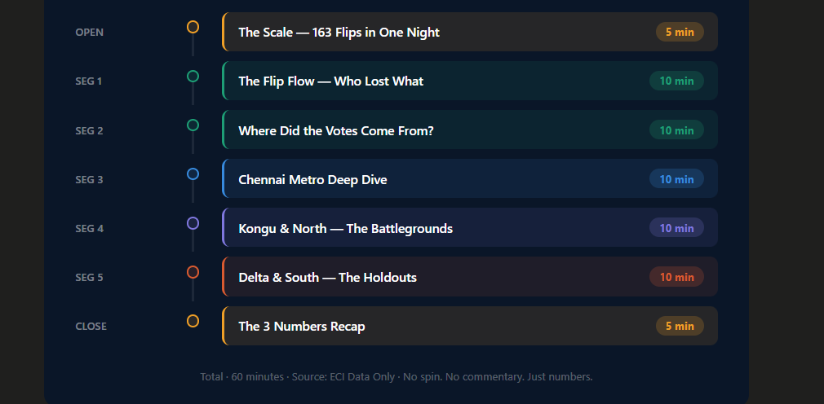
SUGGESTED SHOW STRUCTURE - 60 MINUTES
SOURCE: ECI DATA ONLY · NO SPIN. NO COMMENTARY. JUST NUMBERS.

Slide 9
ALL DATA — ECI ONLY
SOURCES LISTED CLEANLY:
ELECTION COMMISSION OF INDIA — RESULTS.ECI.GOV.IN
TRIVEDI CENTRE FOR POLITICAL DATA (2021 BASELINE)
CODEBASICS PARTICIPANT DATA PACK
DISCLAIMER: "THIS PRESENTATION TAKES NO POLITICAL POSITION. ALL ANALYSIS IS BASED SOLELY ON PUBLICLY AVAILABLE ECI DATA."

Slide 10
THANK YOU
DONE BY
AAKASH .I

